Slide 1

Kidney tumor detection based on deep learning CNN model
Karan singh thakur - 700758703
Keerthi reddy reddigari – 700758353
Akshith reddy sunka – 700758358
SINDHUJA KASAGONI - 700741220

Slide 2
Introduction
Kidney tumors (also called renal tumors) are growth in the kidneys that can be benign or cancerous. Most do not cause symptoms and are discovered unexpectedly when you are being diagnosed and treated for another condition.
Kidney tumor (KT) represents a significant health concern, ranking as the seventh most prevalent tumor globally in both men and women.
Its pervasive impact on society underscores the critical importance od developing effective detection methods to address this health challenge.
Early identification of kidney tumor not only contributes to a reduction in mortality rates but also facilitates the development of preventive strategies and targeted treatment plans.

Slide 3
Motivation
CKD (Chronic Kidney Disease)is a long-term condition where the kidneys do not work effectively.
This can lead to various complications, including an increased risk of cardiovascular disease. Chronic Kidney Disease is often caused by conditions like diabetes and high blood pressure.
Traditionally, the diagnosis of kidney tumors has been a time-consuming and intricate process.
The emergence of deep learning (DL) technologies has ushered in a transformative era in medical imaging diagnostics.

Slide 4
Objective
The objective of the project is to develop a robust machine learning model for the early detection and classification of kidney disease using MLflow for efficient experiment tracking and DVC for version control of data and model artifacts.
By the end of the project, we aim to have a highly accurate and interpretable machine learning model for kidney disease classification.
The integration of MLflow and DVC will ensure efficient experimentation, reproducibility, and collaborative development, setting the foundation for future enhancements and updates to the model

Slide 5
Related work
There is study for renal tumor detection using deep learning approaches on CT scans. And also an efficient algorithm to detect and further analyze renal cancer tumors using CT for patients.
The preprocessing technique involved identifying the noises of a CT scan and removing them with a proper filtering technique.
The classification process is determined based on the patterns of visual appearance that include contrast, size, location, surface area, color, volume, risk, specialization, density, and risk.

Slide 6
Problem statement
This problem statement provides a foundation for developing a comprehensive solution to the challenges associated with kidney tumor diagnosis and segmentation using Deep Learning approaches.

Slide 7
Methodologies
Flask : Flask is a lightweight and web framework written in Python. Its main purpose is to make it easy to build web applications quickly and with minimal code.
HTML CSS : HTML (Hypertext Markup Language) and CSS (Cascading Style Sheets) are fundamental technologies used for building and styling websites.
PYTHON: Python has become the language of choice for data science and machine learning.
ML flow : MLflow is an open-source platform designed to manage the end-to-end machine learning lifecycle.
DVC: DVC is a version control system designed for machine learning projects. It focuses on versioning and managing machine learning datasets and models.
Docker : Docker is a platform that enables developers to automate the deployment of applications inside lightweight, portable containers
Tensorflow : TensorFlow provides a flexible and comprehensive set of tools for building and deploying machine learning models.

Slide 8
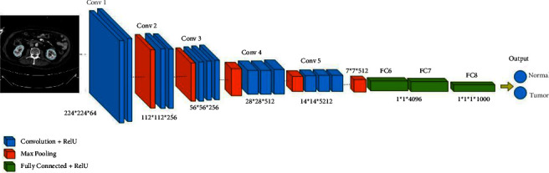
Architecture
Figure-1
Schematic representation of the architecture of detection kidney tumor..

Slide 9
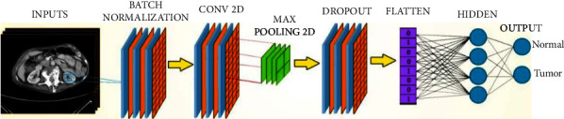
Figure-2
Schematic representation of the CNN architecture of detection kidney tumor.

Slide 10
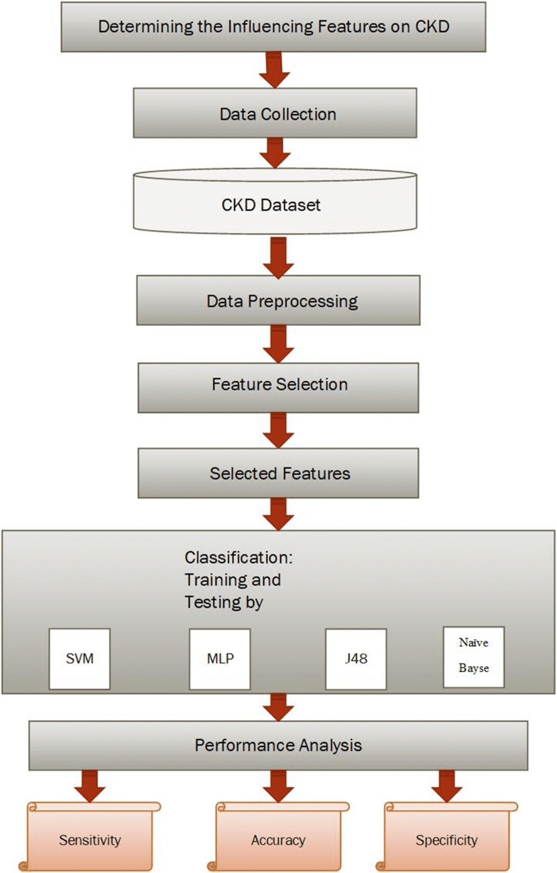
Figure - 3
Conceptual view of the proposed model

Slide 11


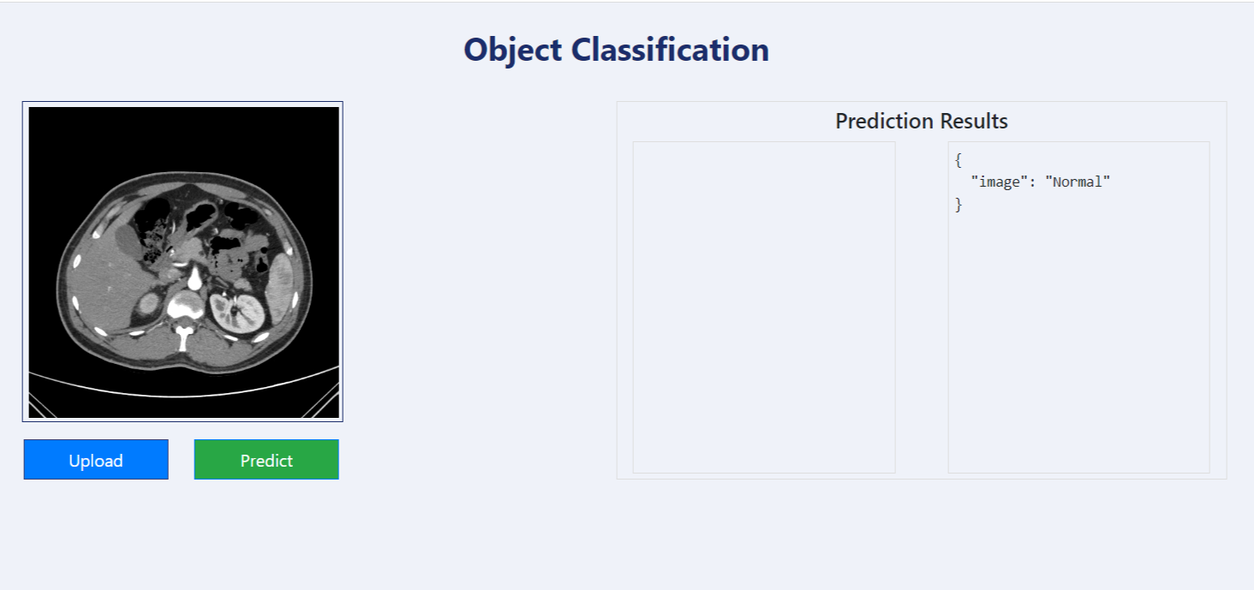
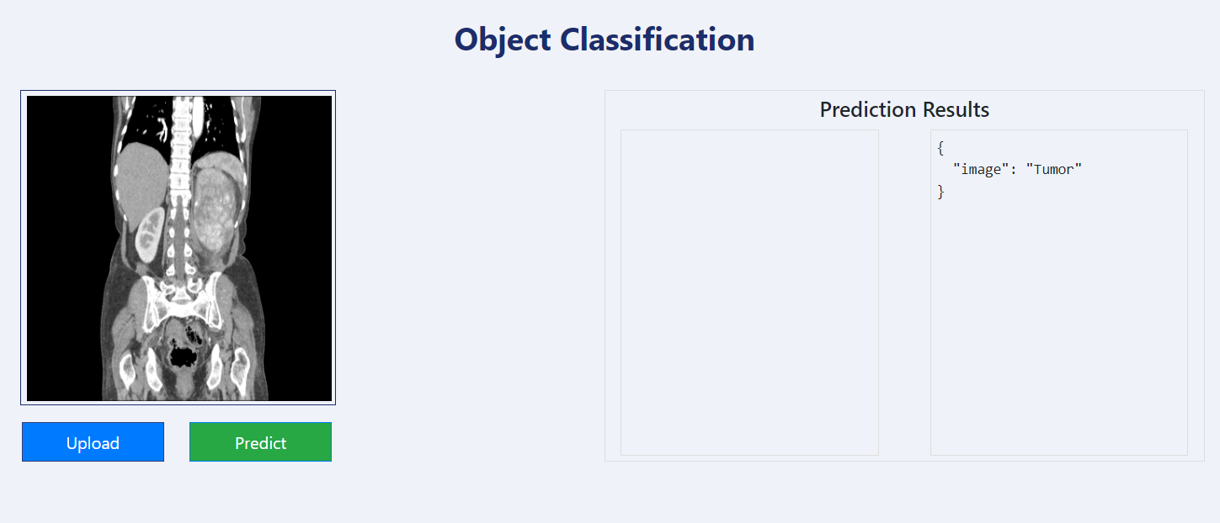



Results
Figure-4
Normal
Figure-5
With Tumor

Slide 12
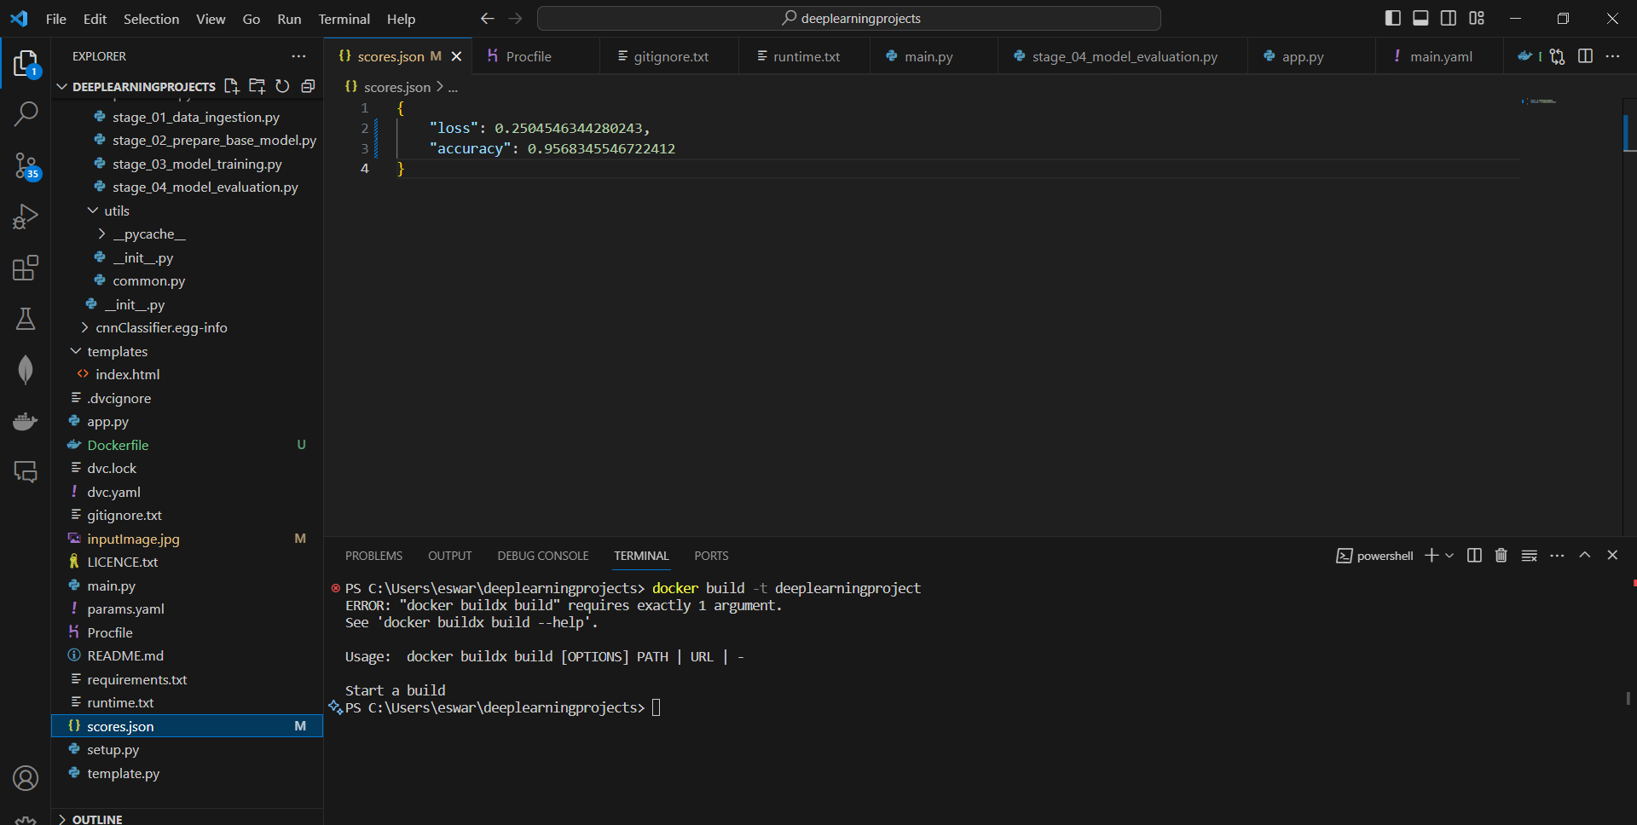
Figure -6
Loss and accuracy

Slide 13
References
1. Gharaibeh M., Alzu’bi D., Abdullah M., et al. Radiology imaging scans for early diagnosis of kidney tumors: a review of data analytics-based machine learning and deep learning approaches. Big Data and Cognitive Computing . 2022;6(1):p. 29. doi: 10.3390/bdcc6010029. [CrossRef] [Google Scholar]
2. Shehab M., Abualigah L., Shambour Q., et al. Machine learning in medical applications: a review of state-of-the-art methods. Computers in Biology and Medicine . 2022;145 doi: 10.1016/j.compbiomed.2022.105458.105458 [PubMed] [CrossRef] [Google Scholar]
3. Xia K.-j., Yin H.-s., Zhang Y.-d. Deep semantic segmentation of kidney and space-occupying lesion area based on scnn and resnet models combined with sift-flow algorithm. Journal of Medical Systems . 2019;43(1):2–12. doi: 10.1007/s10916-018-1116-1. [PubMed] [CrossRef] [Google Scholar]
4. Tanagho J. W. M. E. A. Smith’s General Urology . New york, San francisco: Emil A. Tanagho; 1996. [Google Scholar]
5. Sasaguri K., Takahashi N. Ct and mr imaging for solid renal mass characterization. European Journal of Radiology . 2018;99:40–54. doi: 10.1016/j.ejrad.2017.12.008. [PubMed] [CrossRef] [Google Scholar]

Slide 14
Thank you

